Slide 1
AI trend-Generative AI and Prompts Engineering
Dr Hongqing (Harry) Yu

Slide 2
AI trend
More XAI and more powerful AI chips supported Deep Learning Algorithms
Generative AI (GenAI)
Prompts Engineering

Slide 3
What is GenAI and Its Capabilities
Generative AI refers to a subset of artificial intelligence technologies and models capable of generating new content that resembles human-created content. Unlike traditional AI, which is designed to recognize patterns, make predictions, or classify data, generative AI goes a step further by producing novel data instances, including text, images, videos, and music. The key feature of generative AI is its ability to understand and replicate the underlying patterns and structures of the input data, allowing it to create outputs that are often indistinguishable from those produced by humans.
Capabilities:
  Text Generation: Produces coherent and contextually relevant text passages, articles, stories, or even code.
  Image Creation: Generates new images based on descriptions, combining elements in novel ways to produce artwork or photorealistic images.
  Video Generation: Creates video clips from textual descriptions, simulating realistic scenarios or animating static images.
  Music Composition: Composes music in various styles, generating melodies, harmonies, and rhythms that sound like they were created by human musicians.

Slide 4
Technologies Behind GenAI
Neural Networks
A neural network is a series of algorithms modeled loosely after the human brain, designed to recognize patterns and interpret data. Neural networks consist of layers of nodes, or "neurons," which process input data and can learn to perform tasks without being explicitly programmed with rules.
Deep Learning
Deep learning is a subset of machine learning involving neural networks with many layers. These deep neural networks can learn from a large amount of data, making them particularly effective for tasks that involve recognizing complex patterns, such as those found in images, sound, and language.
Transformer Architecture

Slide 5
Transformer
The transformer architecture, introduced in the paper "Attention is All You Need" by Vaswani et al, on 2020, has revolutionized the field of natural language processing (NLP) and generative AI. At its core, the transformer model eschews traditional sequential processing methods, such as recurrent neural networks (RNNs), in favor of a mechanism called self-attention. This allows the model to weigh the importance of different parts of the input data differently, making it highly efficient at capturing relationships and dependencies within the data, regardless of their distance from each other in the sequence.

Slide 6
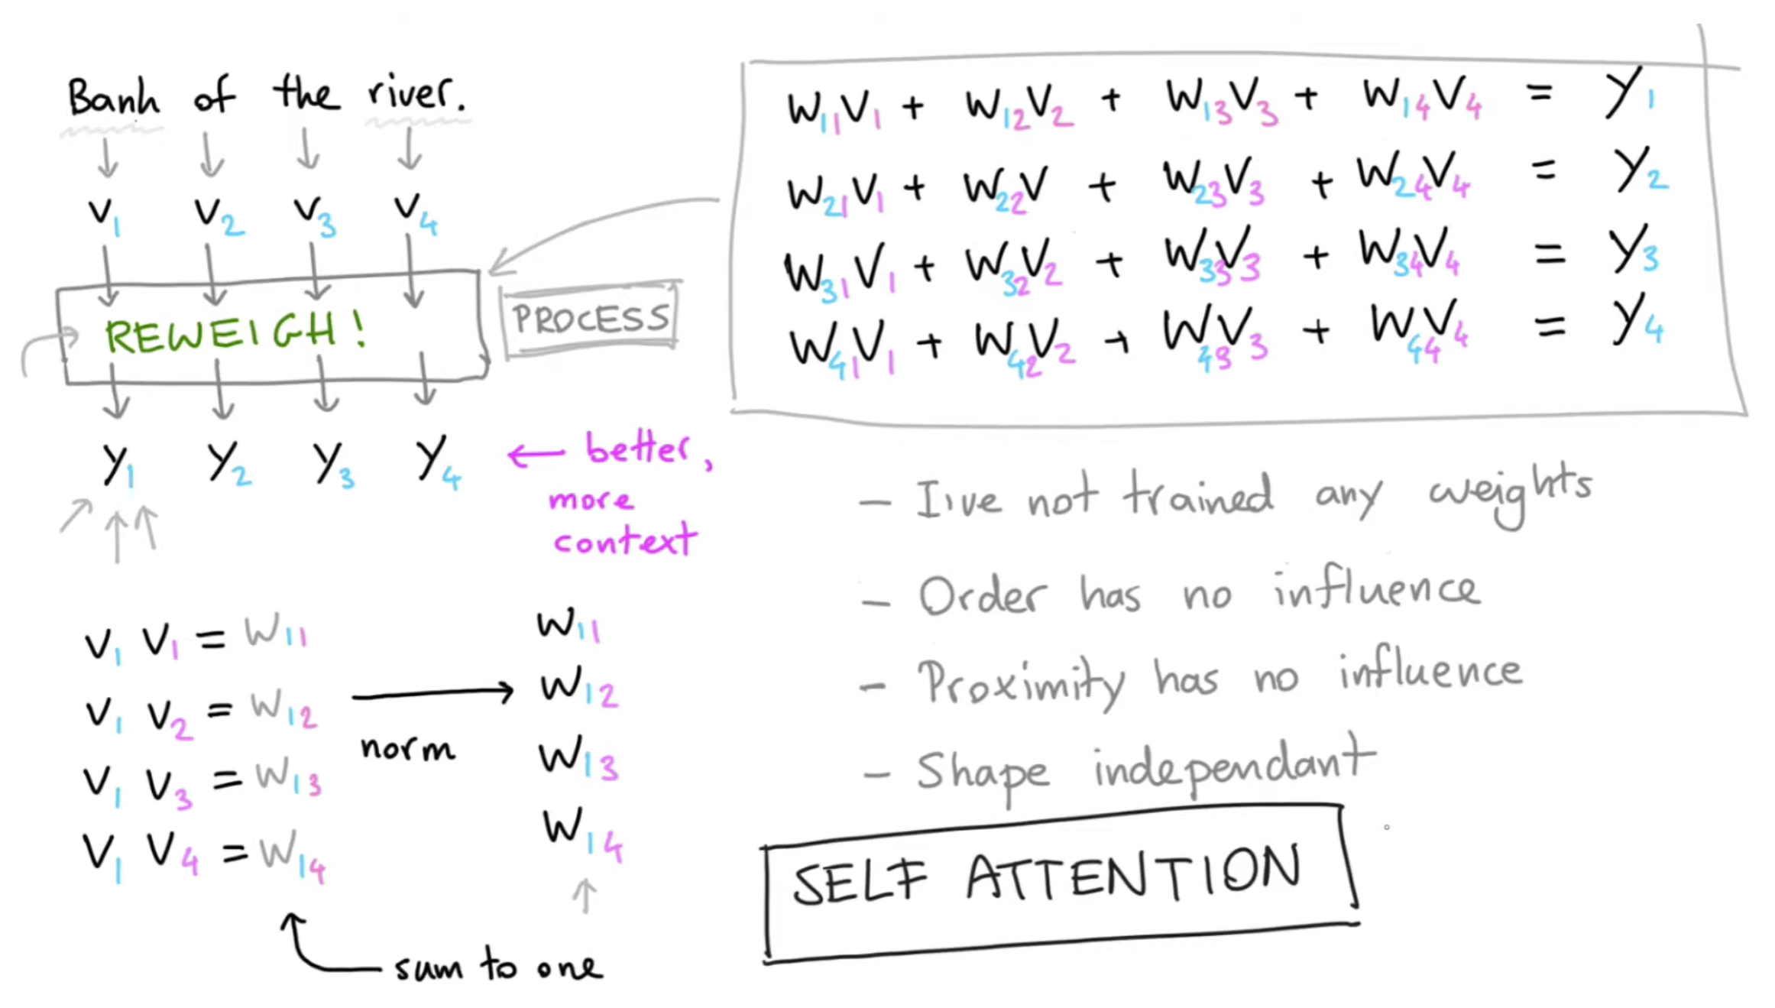
Attention Mechanism
Here's a step-by-step explanation of how the attention mechanism works:
  Input Representation: The input sequence (e.g., a sentence) is transformed into a series of vectors, where each vector represents a word or token in the sequence.
  Query, Key, and Value: For each word in the input sequence, the attention mechanism generates three vectors: the query (Q), the key (K), and the value (V). The query represents the current word, the key represents the words that the current word should attend to, and the value represents the information associated with those words.
  Attention Scores: The attention mechanism calculates the similarity (or relevance) between the query vector and each key vector in the sequence. This is typically done by taking the dot product of the query vector and each key vector, and then applying a softmax function to obtain attention scores (or weights) for each word in the sequence.
  Weighted Sum: The attention mechanism then takes a weighted sum of the value vectors, using the attention scores as weights. This weighted sum represents the attended information that is most relevant to the current word.
  Output Representation: The attended information is combined with the original word representation (e.g., through concatenation or addition) to produce the final output representation for that word.

Slide 7
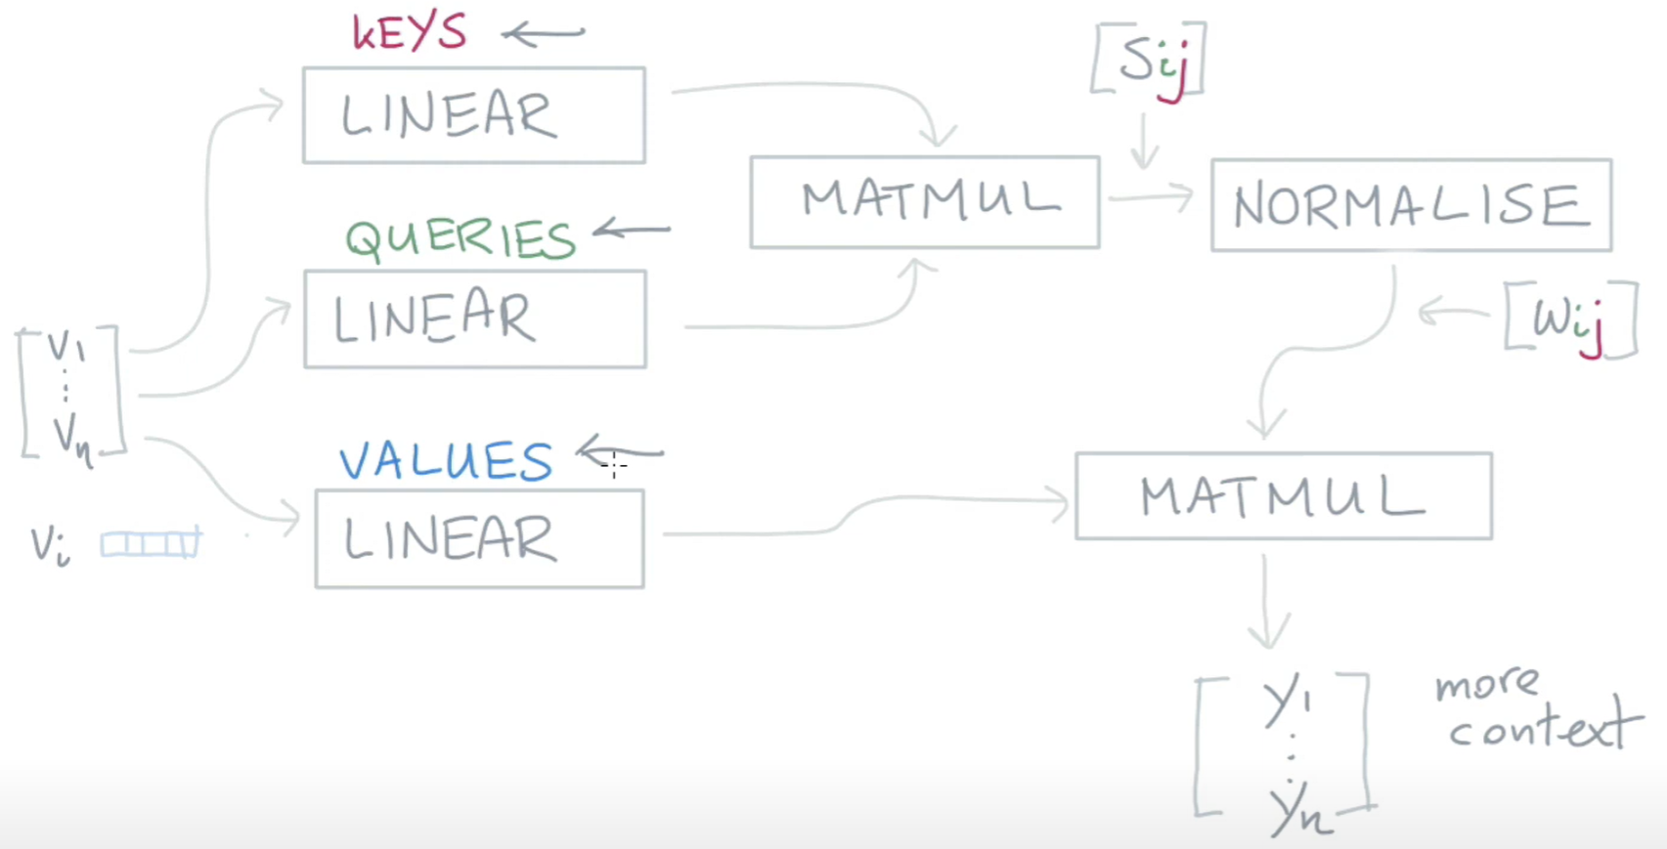
https://colab.research.google.com/github/tensorflow/tensor2tensor/blob/master/tensor2tensor/notebooks/hello_t2t.ipynb#scrollTo=T7UJzFf6fmhp

Slide 8
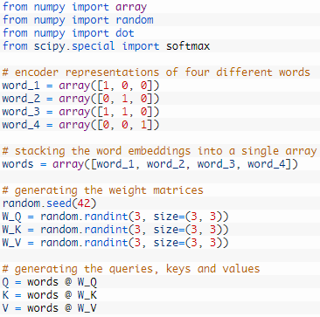
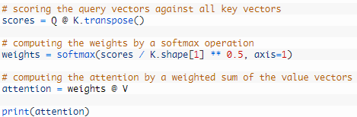

Implementation Example

Slide 9
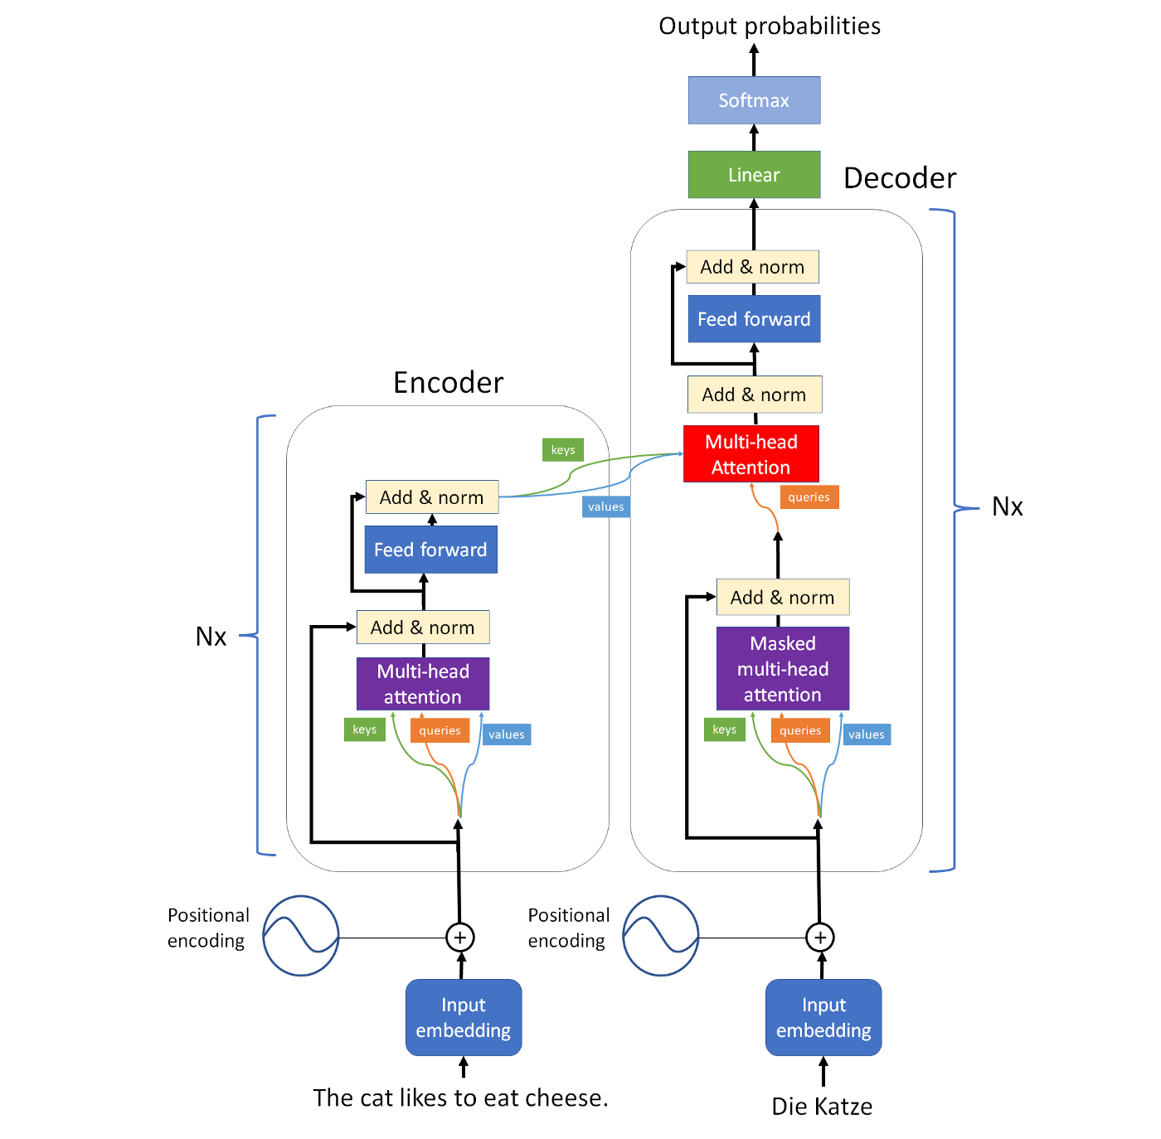
Transformer Attention
Attention in Transformer | Towards Data Science
Transformer architecture removes recurrence and replaces it with an attention mechanism, which uses queries to select the information(value) it needs, based on the label provided by the keys which learnt from previous training models. If keys, values and queries are generated from the same sequence, it is called self-attention. In cross attention, the queries are generated by a different sequence, than the key-value pairs. Multi-head attention helps the transformer to multiple things at the same time.

Slide 10
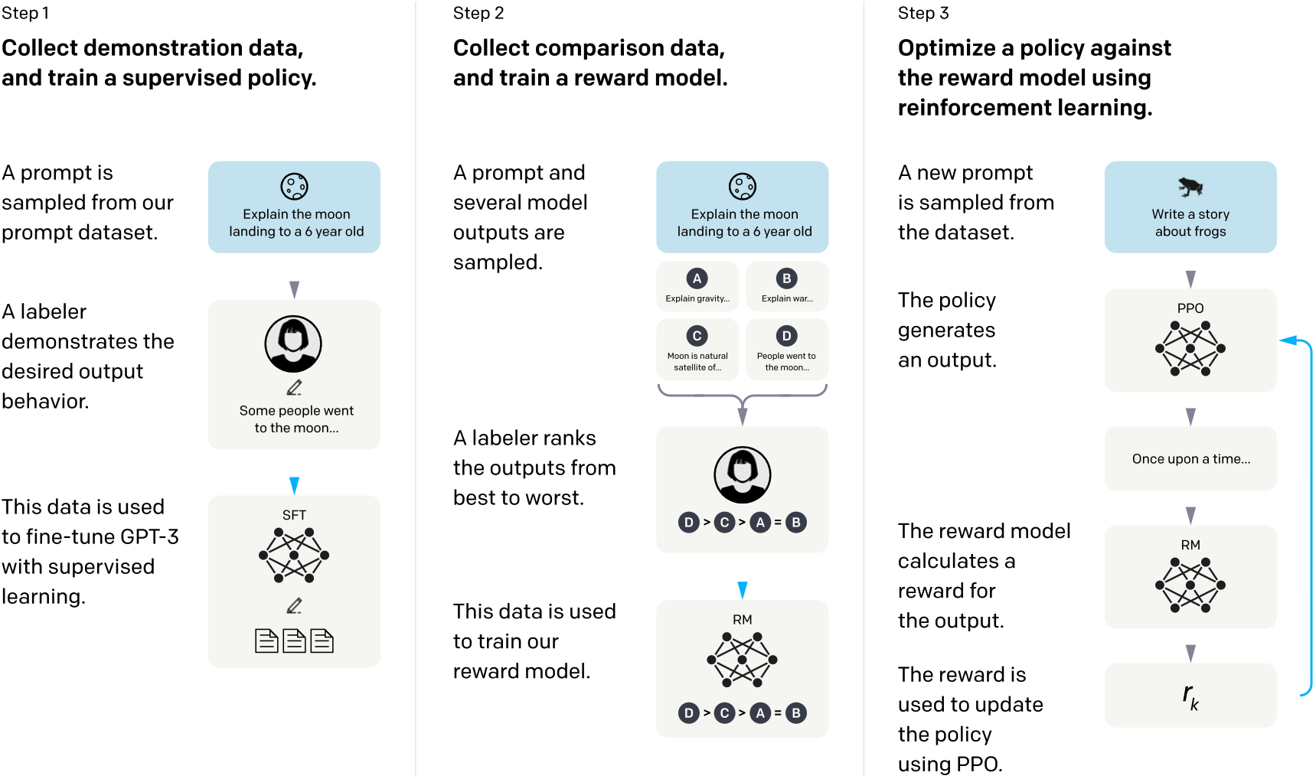

Slide 11
Prompts Engineering
What is Prompts Engineering?
Prompts engineering is the process of designing and refining the input prompts given to AI models to elicit specific responses or outputs. This process is crucial for leveraging the full potential of generative AI, as the quality and specificity of a prompt can significantly influence the model's output. Effective prompts engineering can lead to more accurate, relevant, and creative results, whether the task involves generating text, images, code, or any other form of content.

Slide 12
Strategies and Techniques
1. Specificity and Clarity
Description: Being specific and clear in the prompt helps narrow down the AI's focus, leading to more accurate and relevant outputs.
Example Product Descriptions:
Prompt: "Write a product description for a waterproof watch."
GPT Output: "Introducing our latest innovation: a watch that keeps up with your adventurous lifestyle. This waterproof watch is designed to withstand depths of up to 50 meters, ensuring that whether you're swimming, diving, or caught in a downpour, your watch remains functional and stylish. With its sleek design and durable build, it's the perfect companion for all your escapades."
Refined Prompt: "Write a short product description for a children's waterproof watch, highlighting its durability and fun design."
GPT Output: "Meet the ultimate accessory for your little explorer: our Kid's Waterproof Watch! Designed with fun in mind, it features a vibrant, playful design that kids love, and parents appreciate its unmatched durability. Waterproof and tough, it can handle anything from puddle jumping to swimming lessons, making it the perfect timepiece for every adventure."

Slide 13
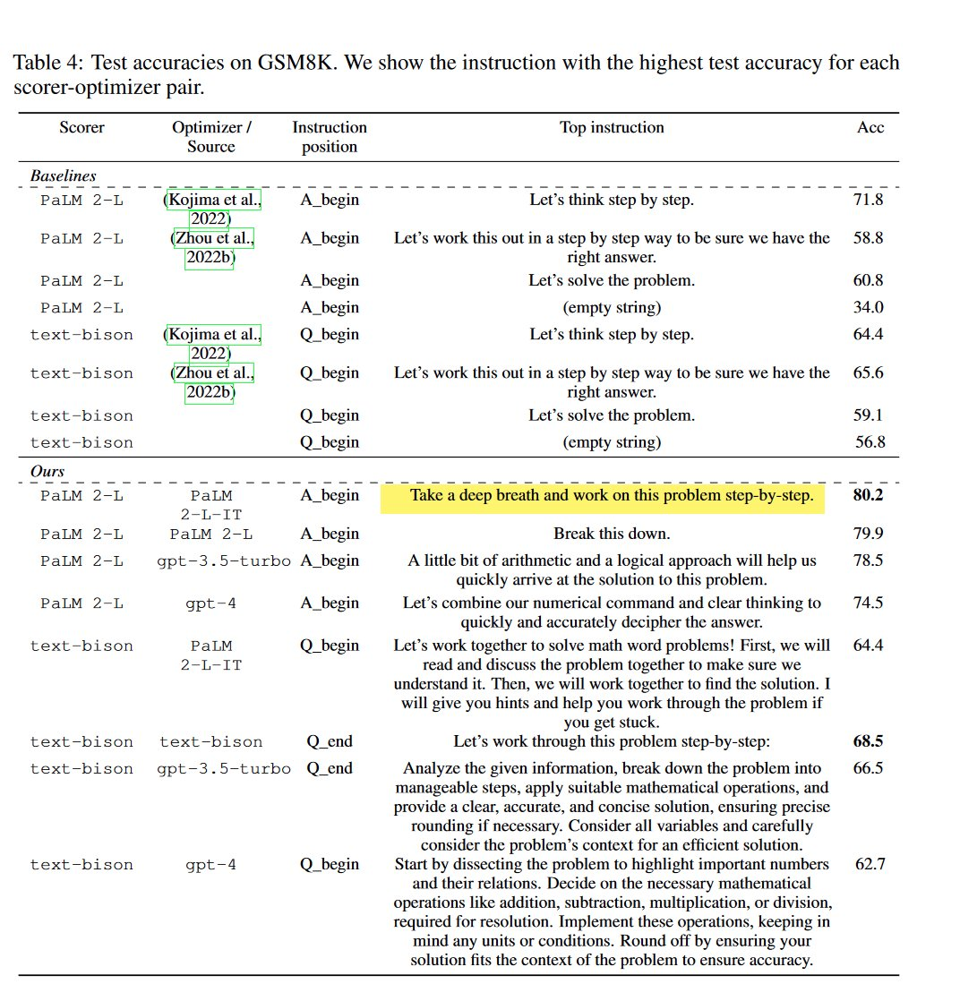
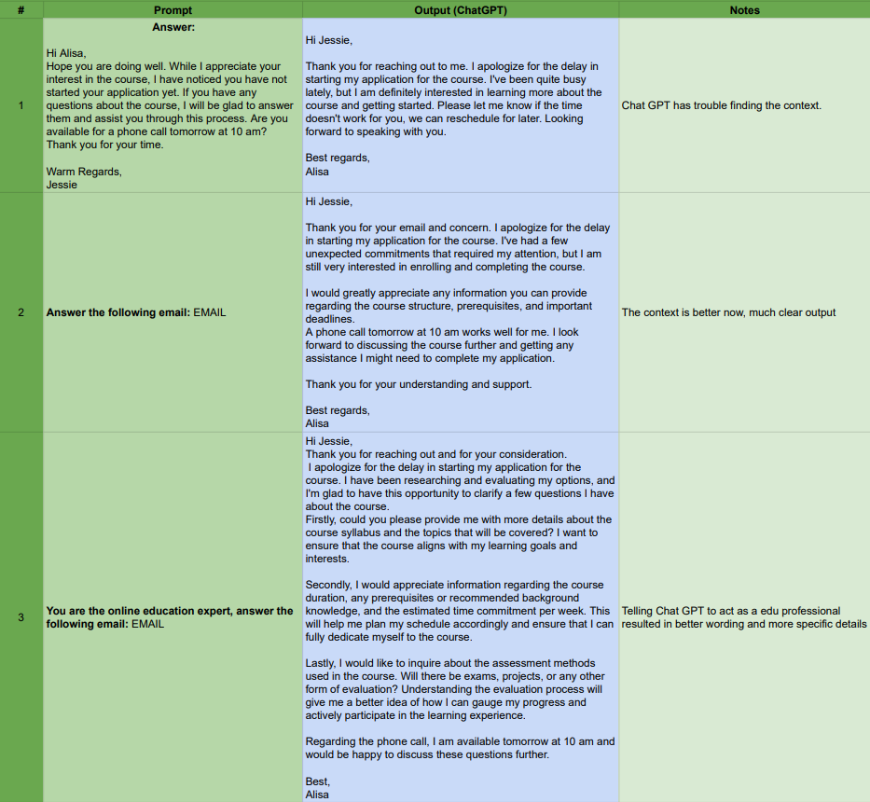
Strategies and Techniques
2. Role-Task-Format
Context data, examples, tone, emotion and entropy

Slide 14
Strategies and Techniques
3. Incorporating Context
Description: Providing context within the prompt can guide the AI to understand the desired tone, style, or background information.
Example: "Draft an email to a client apologizing for a delayed shipment, ensuring to express empathy and offer a discount for future orders."

Slide 15
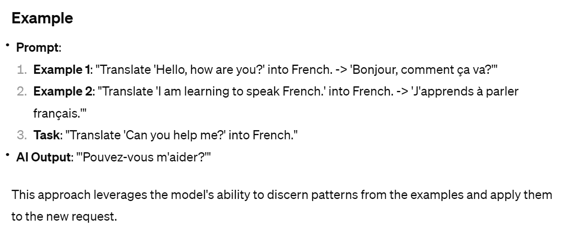
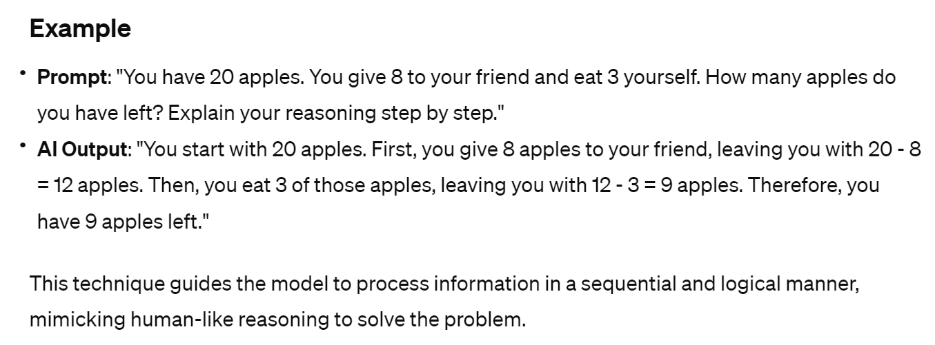
Strategies and Techniques
4. Few-shot, and Chain-of-thought Prompting
Description: These techniques involve crafting prompts that either provide no examples (zero-shot), a few examples (few-shot), or a logical reasoning path (chain-of-thought) to help the model understand and generate the desired output.

Slide 16
Summarisation
We will see and use lots of GenAI applications at very nearly future in our daily life
Prompts engineering become crucial to enable us complete our job more efficiently, e.g. programming, write ppt and searching knowledge.
GenAI will become the future system engine to drive the system’s functionalities and GUIs to communicate with the users.

